Slide 1
World War I
1914-1919

Slide 2
4 MAIN Causes of WWI
M
A
I
N
ilitarism
lliances
mperialism
ationalism

Slide 3
Causes of WWI
Militarism
Aggressive preparation for war
Conscription – draft begin to double size of European armies
Example – Russian Army the largest – 1.3 million
Mobilization Plans – the readying of troops for war
Military had more power over government and foreign policy
Great powers included Austria-Hungary, France, Germany, Great Britain, and Russia

Slide 4
Causes of WWI
Alliances
A system of Alliances or relationships develops amongst European nations to help bolster their own security
The “I got your back” theory
The Alliance forced nations to come to each others aid in the event of attack
Triple Alliance – Germany, Austria-Hungary & Italy
Triple Entente – France, Great Britain & Russia
Problems with this????

Slide 5
Causes of WWI
Imperialism
Scramble for colonies in late 1800’s
In Africa, Asia, and the pacific
Competition for remaining lands
Britain, France, and Japan were leaders in colonization
Germany was envious
Realization that lands had to be taken from other colonizers to expand

Slide 6
Causes of WWI
Nationalism
Countries acting in their own best interest even using military force to enhance their interests
Alsace-Lorraine – small strip of land between Germany and France, once part of France the Germans conquered it in 1871.
France wants it back, Germany values land for its history and location
Ethnic diversity in Europe led many to fight for their own ethnic independence

Slide 7
Start of the War
Archduke Francis Ferdinand was assassinated on June 28, 1914
Austria-Hungary believed that Serbia was behind the assassination
Austria-Hungary declared war on Serbia July 28, 1914
Set off a chain reaction through the alliances

Slide 8
War begins
Russia began mobilization to protect Serbia
Germany (Austria-Hungary ally) demands Russia to stop mobilization
Russia refuses
France (Russia’s ally) and Germany begin mobilization
August 1, 1914- Germany declares war on Russia

Slide 9
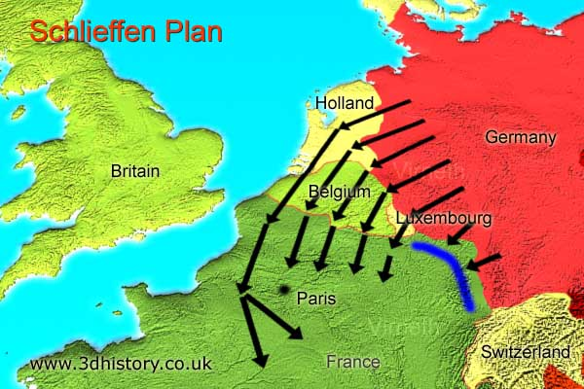
War begins
Schlieffen plan- Germany would take out France first and then move east to Russia
Germany had to go through Belgium
Caused Great Britain to join the war on Aug 4, 1914

Slide 10
Alliances
Central Powers
Germany’
Austria-Hungary
Ottoman Empire (late 1914)
Bulgaria
Allies
Russia
France
Serbia
Great Britain
Italy (spring 1915)
Romania (1916)
United States (1917)

Slide 12
The War
Stalemate-neither side had an advantage
Trench warfare- digging trenches and fighting in “no man’s land” to get to the other trench
Neither side gained more than a few miles at a time

Slide 13
Trench Warfare

Slide 14
The War
Modern Warfare – New technology changes the war
Machine guns, rapid-fire artillery, Hand grenades, and Poison gas
Led to large death toll
Ex. British suffered 20,000 deaths in one day at Somme
Loss of morale

Slide 15
Hand Grenades

Slide 16
Poison Gas

Slide 17
Submarines / U Boats

Slide 18
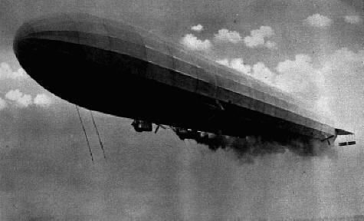
War in Air

Slide 19
Tanks

Slide 20
American Response
Many Americans felt personally involved
More than 1/3rd of US population were immigrants
1/4th of immigrants were from Germany
Sided with Central Powers
Most Americans sided with Allies
Ancestry traced to Britain
Kaiser Wilhelm II of Germany was an autocrat- ruler with unlimited power
Propaganda- information to sway public opinion
America stayed neutral to protect investments with European Countries on both sides

